Slide 1
Osteogenesis Imperfecta
Brittle Bones Disease

Slide 2
Some Facts.....
Eight Types, ranging from Type 1 to Type 8
Type | Description
I | mild
II | severe and usually lethal in the prenatal period
III | considered progressive and deforming
IV | deforming, but with normal sclera’s
V | shares the same clinical features of IV
VI | shares the same clinical features of IV,
VII | recessive
VIII | severe to lethal, recessive

Slide 3
Some More Quick Facts
Someone with OI can go onto have several hundred fractures in a lifetime
Some Common Symptoms of Type IV OI
Between Type I and Type III in severity.
Bones fracture easily. Most fractures occur before puberty.
Shorter than average stature.
Sclera are white or near-white (i.e. normal in colour).
Mild to moderate bone deformity.
Tendency toward spinal curvature.
Barrel-shaped rib cage.
Triangular face.
Brittle teeth possible.
Hearing loss possible.
Collagen improperly formed.

Slide 4
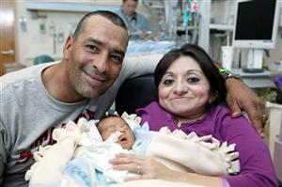
Short Stature

Slide 5
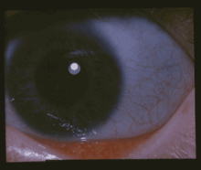
Blue Sclera

Slide 6
Bowed Legs

Slide 7
Bowed Arms

Slide 8
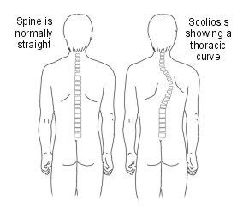
Scoliosis

Slide 9
Complications
Hearing loss
Heart failure
Respiratory problems and pneumonias due to chest wall deformities
Spinal cord or brain stem problems
Permanent deformity

Slide 10
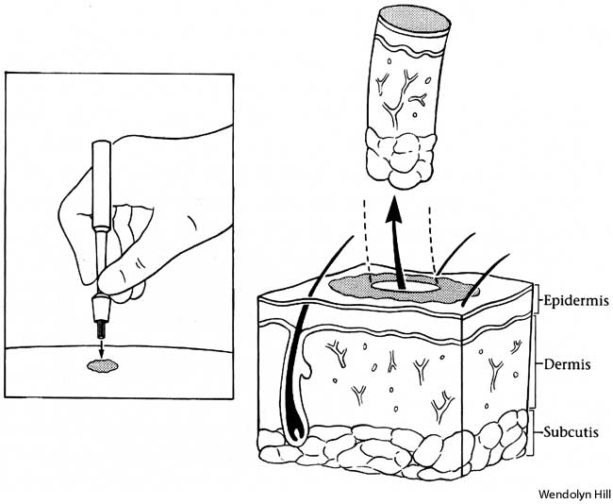
Skin Punch Biopsy

Slide 11
An interesting statistic
In the United States it is unknown the number of people who are affected by OI, but the best estimates suggests that a minimum of 20,000 and possibly as many as 50,000 people may be affected out of a growing population of over 300 million people

Slide 12
Another interesting statistic
In the US, incidence of OI by type is as follows:
Type I - One per 30,000 live births
Type II - One per 60,000 live births
Type III - One per 70,000 live births
Type IV – Very Rare Internationally. A higher incidence has been observed in 2 major tribal groups in Zimbabwe.

Slide 13
Contact me
Twitter:
@ThinesG
Email:
thinesganesh@gmail.com

